Slide 1
Modeling Passive Daytime Radiative Cooling Devices (PDRCs) using COMSOL Multiphysics™
Student: Collins Munene Kariuki
Advisor: Professor Janice Hudgings

Slide 2
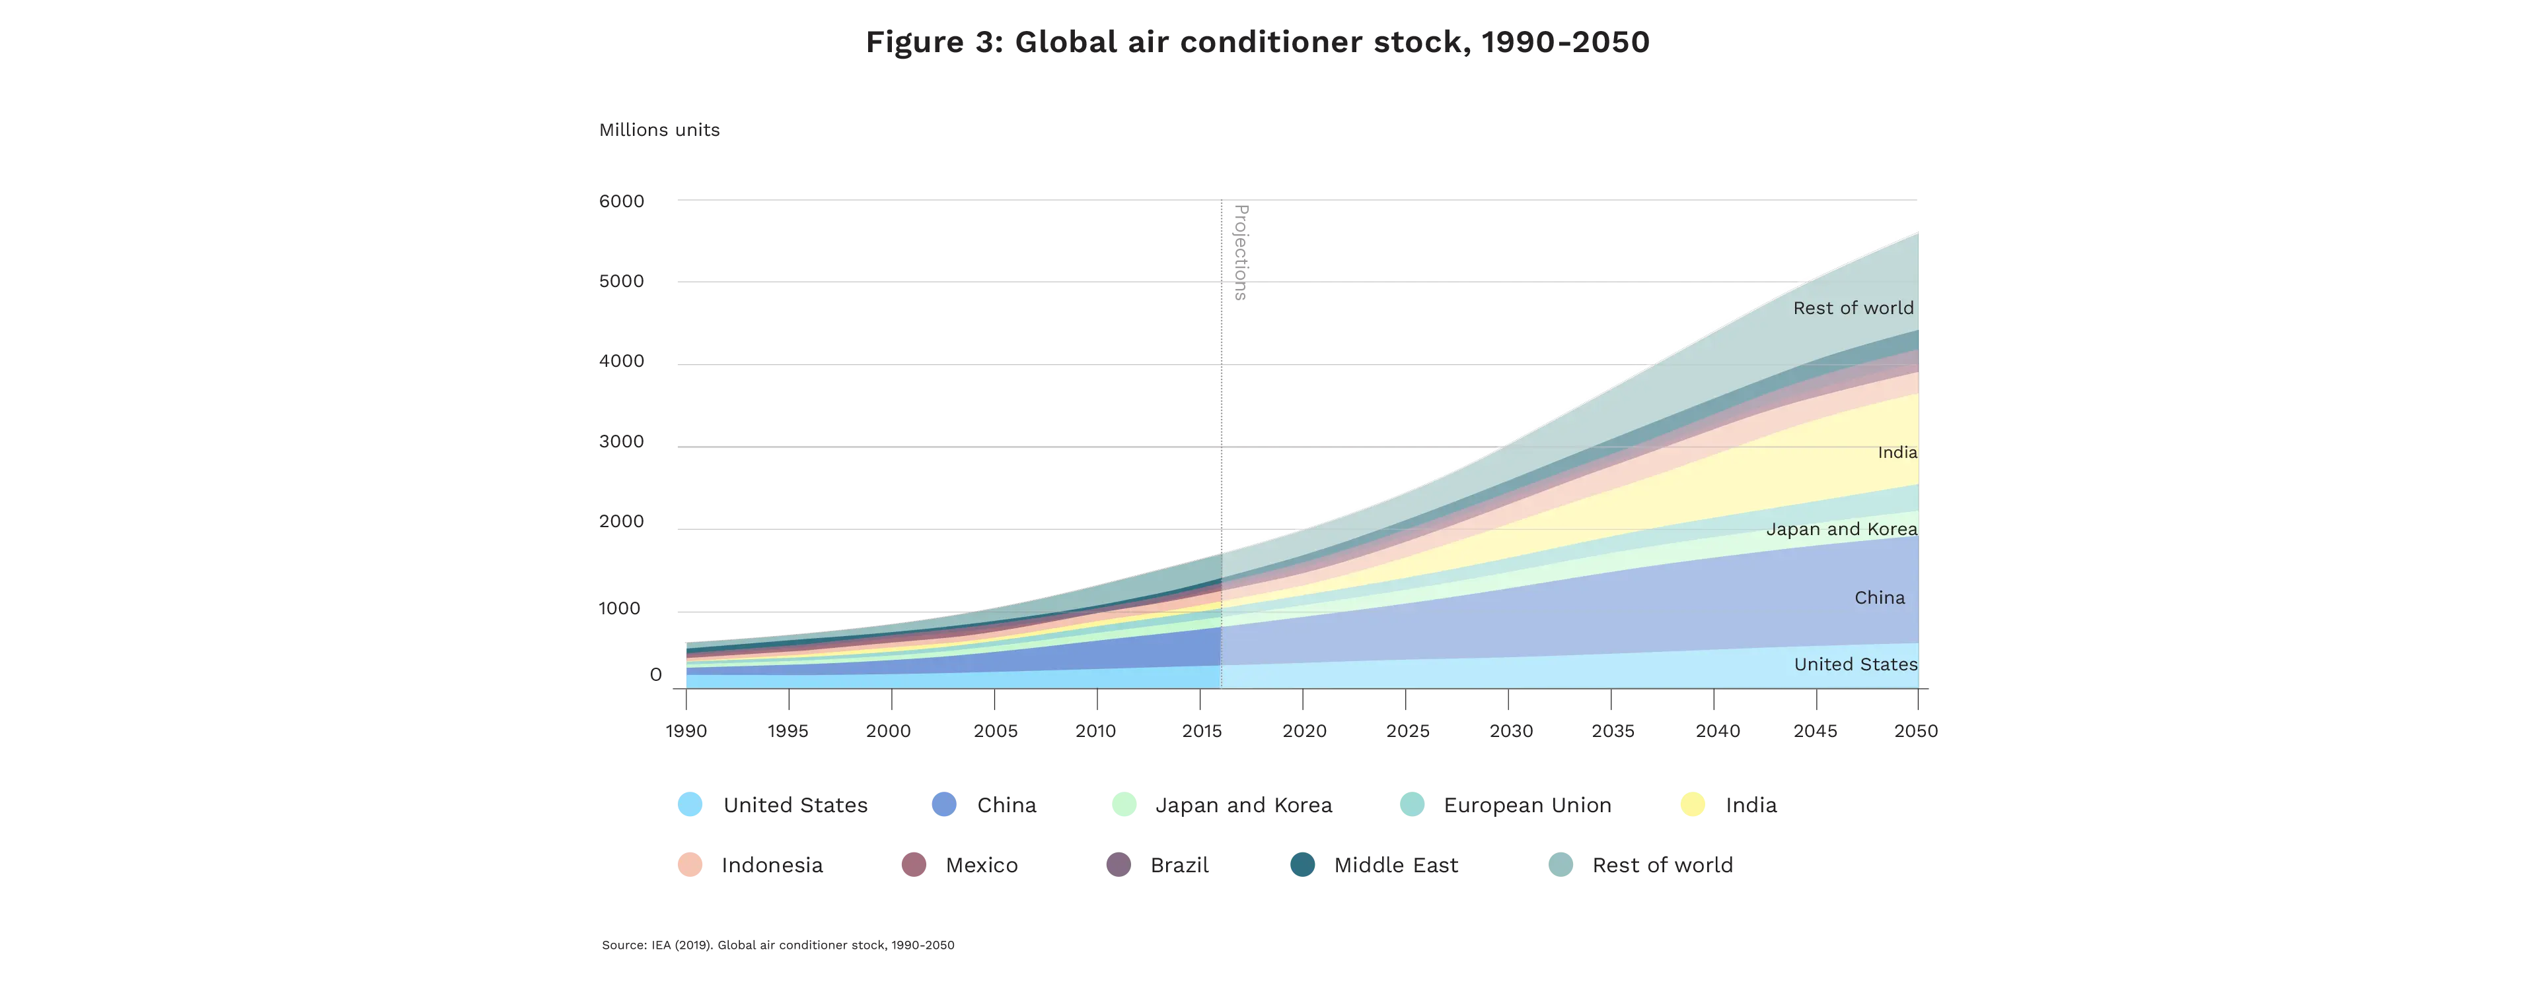
Motivation.
Global warming
More emissions and heat dumped outside
More AC use
The heat island effect describes how urban areas are significantly warmer than their rural counterparts, largely because of human activities.
By 2050, around 2/3 of the world’s households could have an AC. China, India and Indonesia will together account for half of the total number.

Slide 3
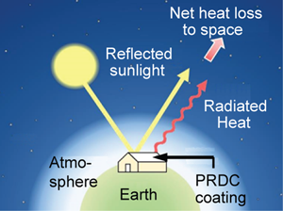
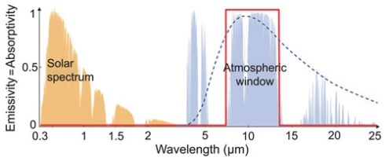
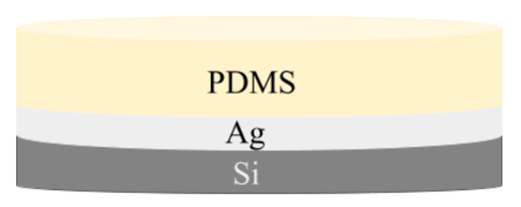
So, What are PDRCs?
Radiative passive cooling occurs when objects emit more radiation than the combined radiation they absorb. Thus, radiative passive cooling is an electricity-free method for cooling terrestrial entities
Passive Daytime Radiative Cooling: Principle, Application, and Economic Analysis (Yang & Zhang, 2020)
Passive Daytime Radiative Cooling: Principle, Application, and Economic Analysis (Yang & Zhang, 2020)
0% absorptivity (100% reflectance) in the solar spectrum (0.3–2.5 μm), so the surface is not heated by sunlight in daytime at all.
Emittance of 1 in the λ = 8–13 μm window of the atmosphere, where it is partially transparent, since there is limited infrared absorption by gas molecules.
Modeling and Testing Passive Daytime Radiative Cooling Devices (DiBari, 2023)

Slide 4
Thesis Goals.
Use COMSOL to model PDRCs but COMSOL is… hard
Plotting the reflectance (R) vs wavelength for the basic Si + Ag + PDMS structure.
Understanding how to use COMSOL Multiphysics
To do this I verify simulations on (anti)-reflectivity by benchmarking them against established optics literature.
- Modeling anti-reflectance coatings.
- Modeling (multi-layer) high reflectance coatings.

Slide 5
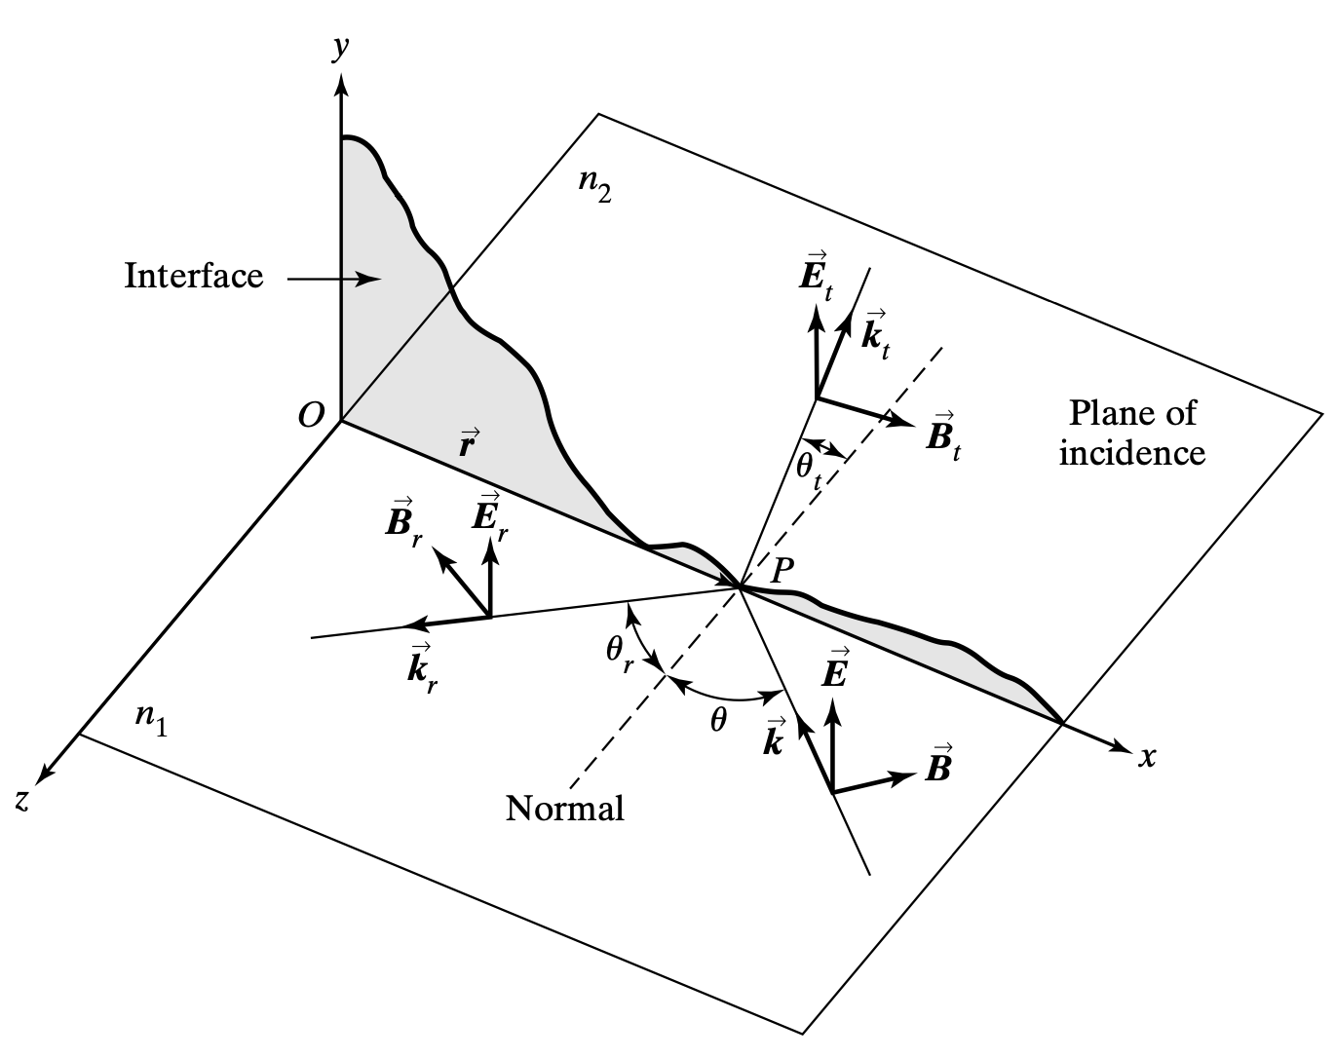
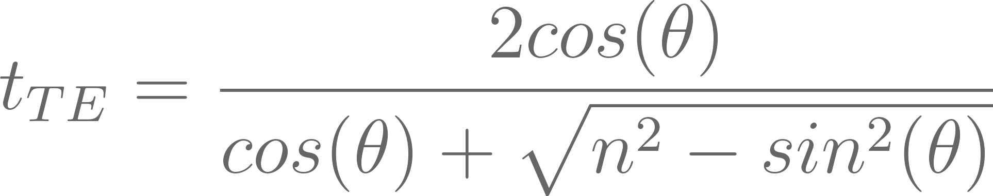
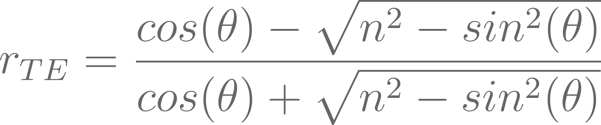
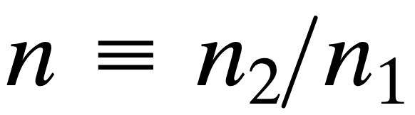
Theory (Single Interfaces & Fresnel Equations)
F. L. Pedrotti, L. M. Pedrotti, and L. S. Pedrotti, Introduction to optics, 3rd ed. 2007.
The Fresnel equations describe how light behaves when it encounters the boundary between two different media, such as glass and air.
They determine the proportion of light that is reflected or transmitted at the interface, based on the incident angle and the polarization of the light.

Slide 6
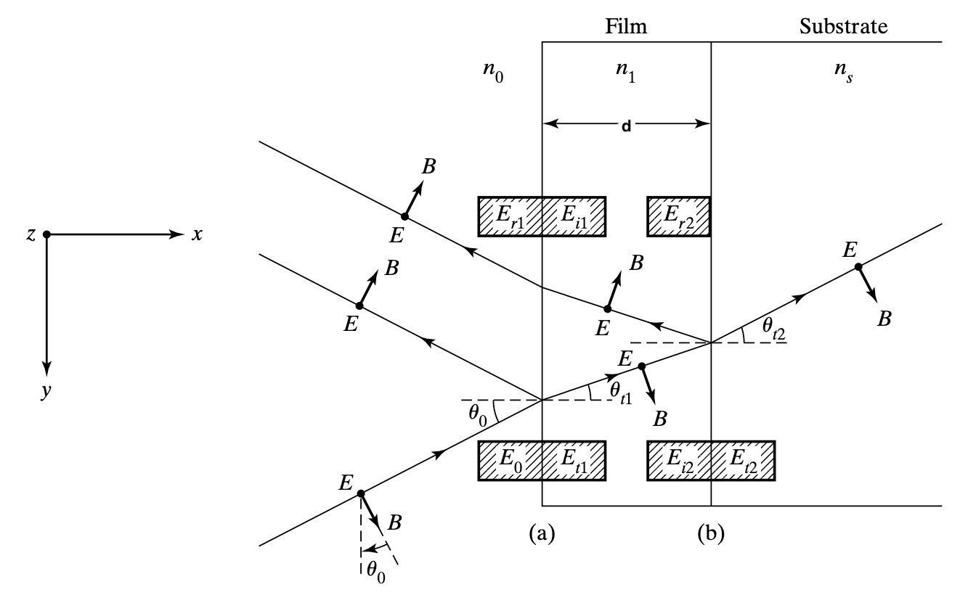
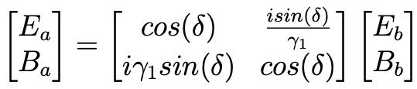
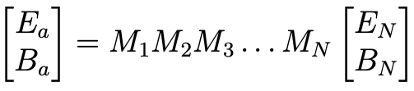
Theory (Multiple Interfaces & the Transfer Matrix)
When light encounters multiple interfaces the complexity of reflection and transmission calculations increases significantly.
The transfer matrix approach allows for the systematic calculation of light behavior through multiple layers with varying refractive indices and thicknesses.
n is a function of the wavelength (λ) of light… we need COMSOL!!
F. L. Pedrotti, L. M. Pedrotti, and L. S. Pedrotti, Introduction to optics, 3rd ed. 2007.

Slide 7
COMSOL Multiphysics ™
Initialization of the modelling environment
Geometry construction
Material property specification
Physics boundary conditions
Mesh generation
Simulation execution
Results post-processing

Slide 8
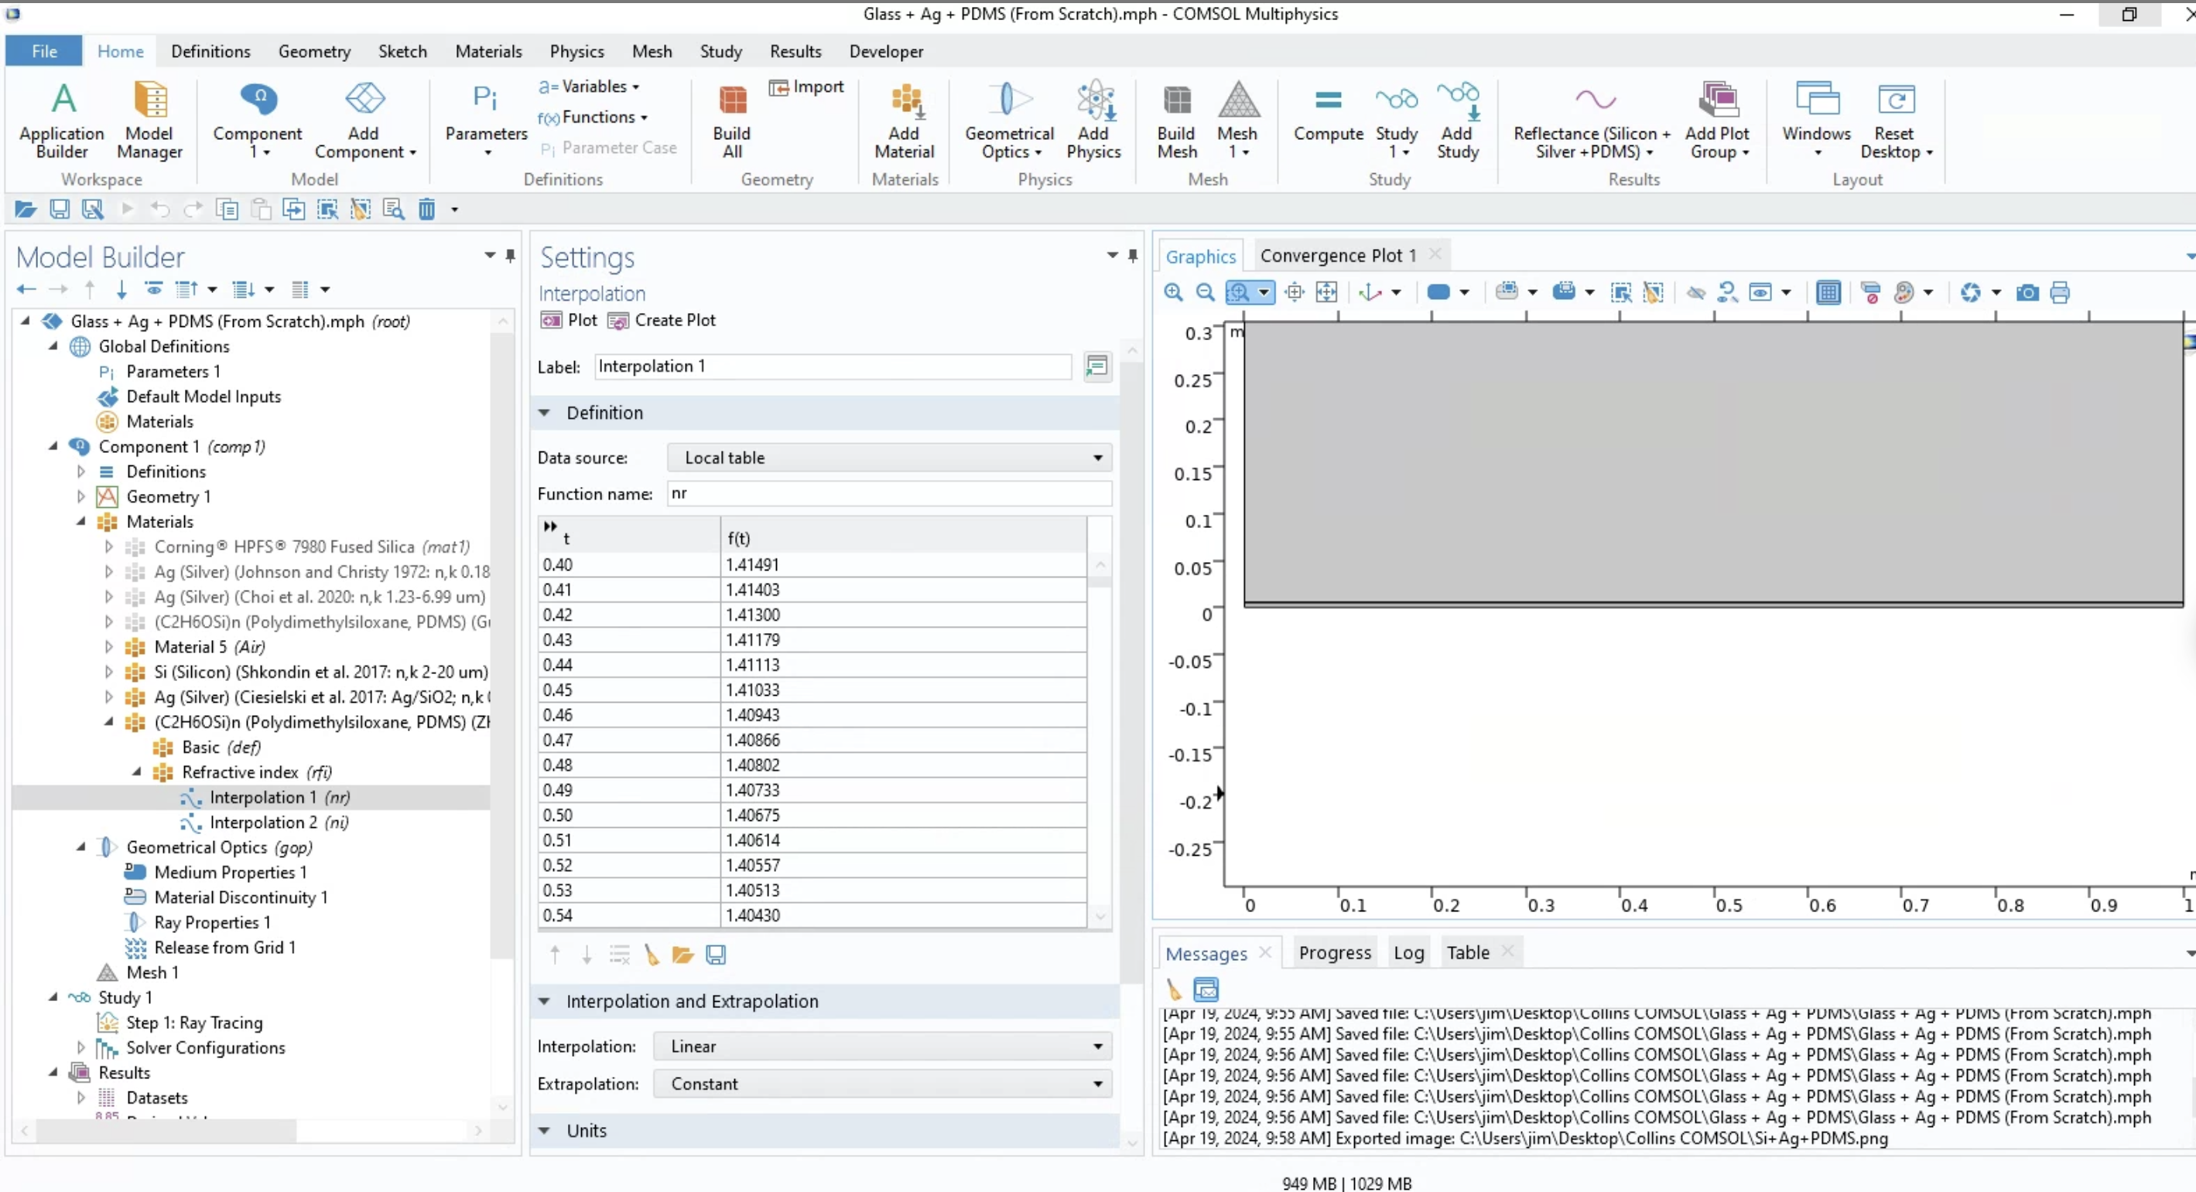

Slide 9
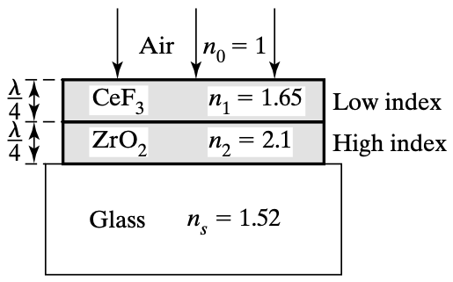
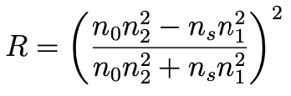
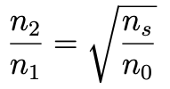
Validation of Models Against Established Literature
Anti-reflectance coatings are designed to minimize reflection and maximize transmission of light through strategic manipulation of refractive indices across different layers.
F. L. Pedrotti, L. M. Pedrotti, and L. S. Pedrotti, Introduction to optics, 3rd ed. 2007.

Slide 10
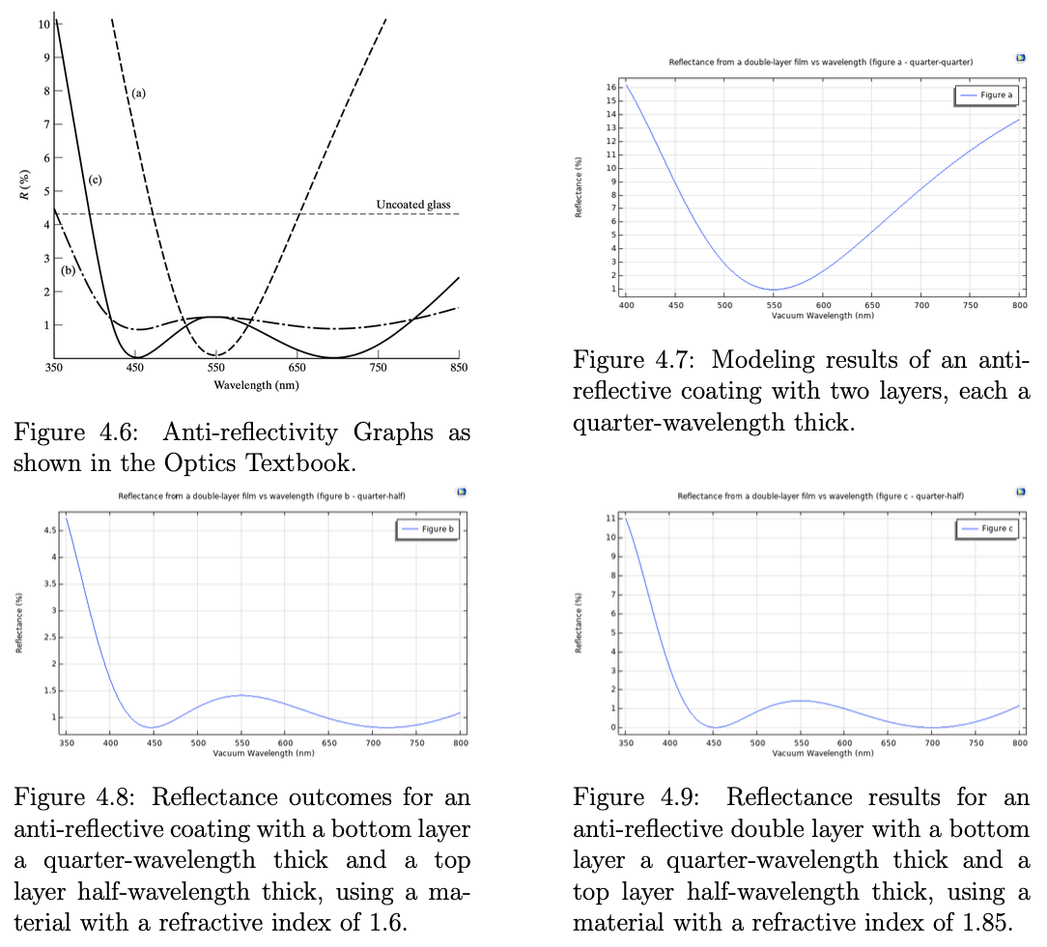
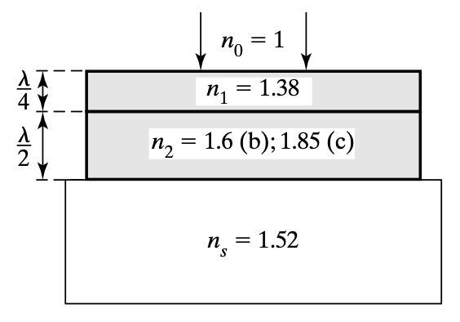
Validation of Anti-Reflectance Coatings Against Established Literature
F. L. Pedrotti, L. M. Pedrotti, and L. S. Pedrotti, Introduction to optics, 3rd ed. 2007.

Slide 11
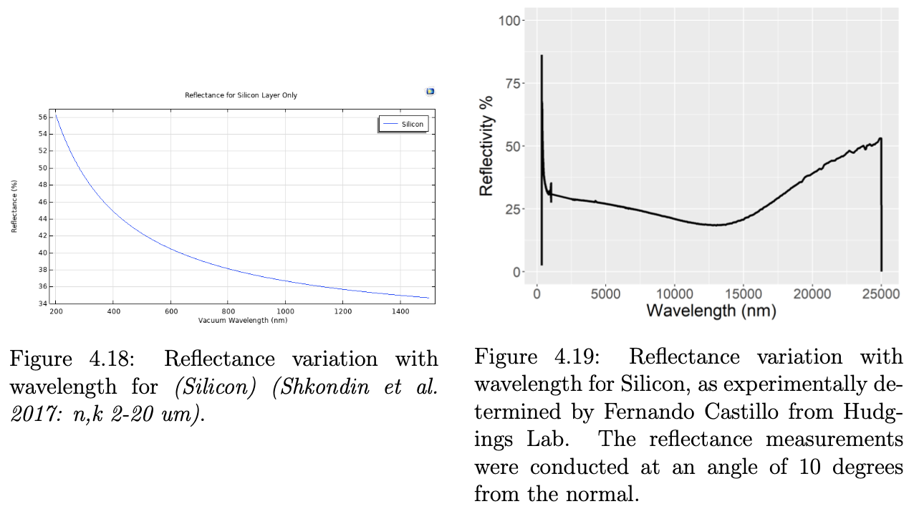
PDRC Device Modeling (Silicon Only)

Slide 12
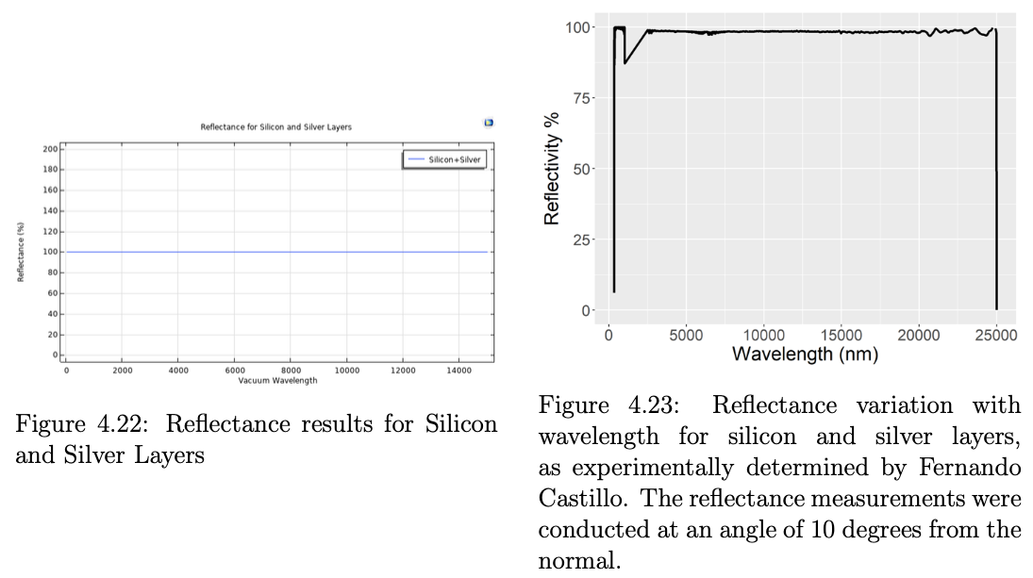
PDRC Device Modeling (Si + Ag)

Slide 13
Conclusions and Future Work
COMSOL is a powerful tool when it comes to simulating various phenomena across different fields of physics.
It is reassuring to know that we can confirm our simulations
against established optics theoretical literature.
Successfully modeled (anti)-reflectance coating, (multi)-layer high-reflectance coatings, Fresnel equations etc.
Adding more materials on top of the PDMS layer to fulfill PDRC design criteria more effectively, experimenting with various thicknesses and refractive indices to exploit constructive interference across multiple interfaces more efficiently.
The translation of computational models into physical prototypes for empirical validation in lab settings, comparing simulated reflectance with real-world performance.
Development of reflectance versus angle of incidence models to aid in the characterization of PDRC behavior throughout the day.

Slide 14
Acknowledgements
WILL INCLUDE ACKNOWLEDGEMENTS IN TIME FOR MY THESIS PRESENTATION, I PROMISE

